Slide 1


Data Warehouse for Drug Enforcement Administration
By:
Rishav Singh: 10536571
Nayil: 10541185
Vishal Tyagi: 10535541
Vivek Sanu: 10534553

Slide 2
Flow of presentation
Introduction
Vision & Goal
Key stake holders
Schema
ETL
Reports
Conclusion
Neo4J
XML

Slide 3
Introduction
Connecticut takes third place in terms of real GDP per capita of $64,511 for 2018 and a per-capita, current-dollar GDP of $73,643 in United States.
According to the National Survey on Drug Use and Health (NSDUH), 9.10 % of Connecticut residents reported using drugs in recent past and this is more than national average of 8.82 %.
Though Marijuana is common drug but here in Connecticut 3.48 % residents reported using illicit drug other than Marijuana which is more than average of 3.33 % national average.
These figures worried Drug Enforcement Administration and they would like to know the exact situation of the state by knowing the facts like:
Consumption of which drug is significant in Connecticut, so by knowing this they can track the drug source.
In which county drugs are more popular, this will help them to increase the surveillance in those counties.
Finally, can alert people about the consequence of doing drugs by using facts and figures in their campaign.

Slide 4
Vision & goal
The vision and goal of this project is to alert Drug Enforcement Administration about drugs which are causing most deaths in the Connecticut state and along with the name of counties which are highly vulnerable to drugs with other contributing factors.

Slide 5
Key stake holders
Drug Enforcement Administration (DEA)
Inter-American Drug Abuse Control Commission (CICAD)
Secretariat for Multidimensional Security (SMS)
State and Local Police

Slide 6
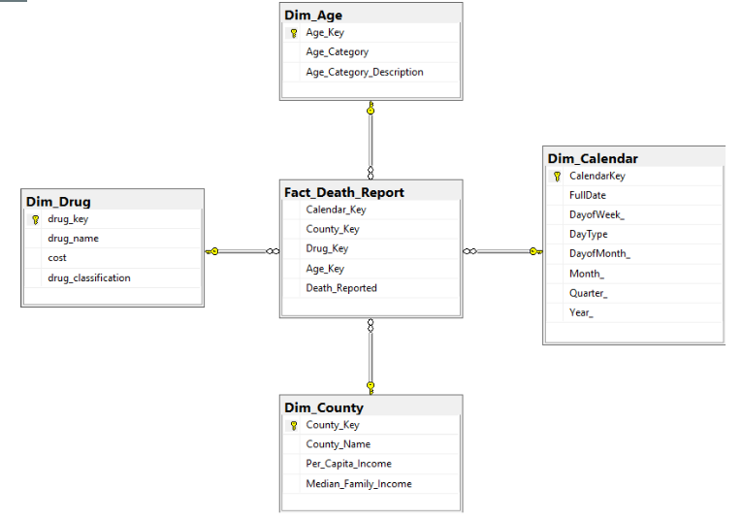
schema

Slide 7
Without Data You're Just Another Person With An Opinion
-W. Edwards Deming

Slide 8
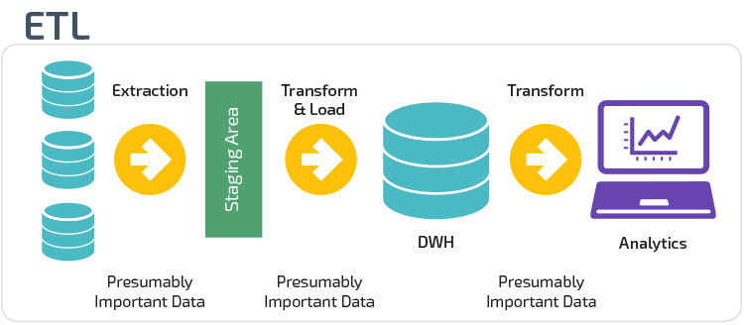
ETL

Slide 9
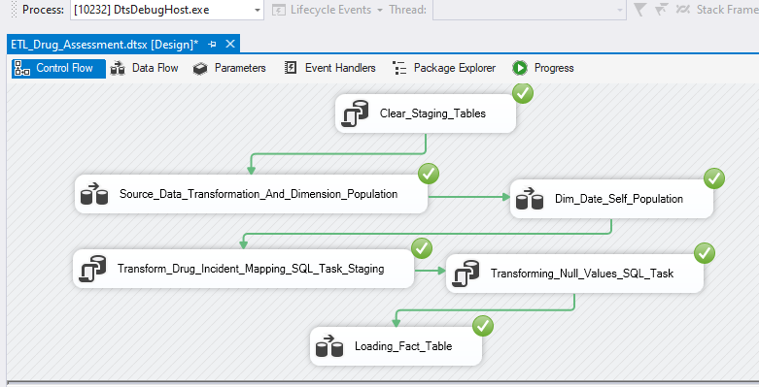
PROCESS FLOW

Slide 10
extraction
Data Sources
Source Data: provided by US govt in excel format
County Data: Extracted using R from Wikipedia
Drug Data: Various Sources
Age Categorization: Provided by United Nation WHO

Slide 11
Why Staging Tables?
Data was complex
To map drugs consumed by people from drug dimension
Make lookup into Dimenion Dim_Drug possible
Ease in transformation

Slide 12
Why staging
Source_Data
Id
...
...
Drug 1
Drug 2
…..
Drug 15
Dim_Drug
Id
Drug Name
….
One person could consume more than one drug so Look up was not possible

Slide 13
Staging tables
Source_Data
Incident_Id
...
Drug 1
….
Drug 15
AgeCategory
Drug_Incident_Mapping
id
Incident_Id (FK)
Drug

Slide 14
Clear staging tables
First process
Delete everything from staging tables

Slide 15
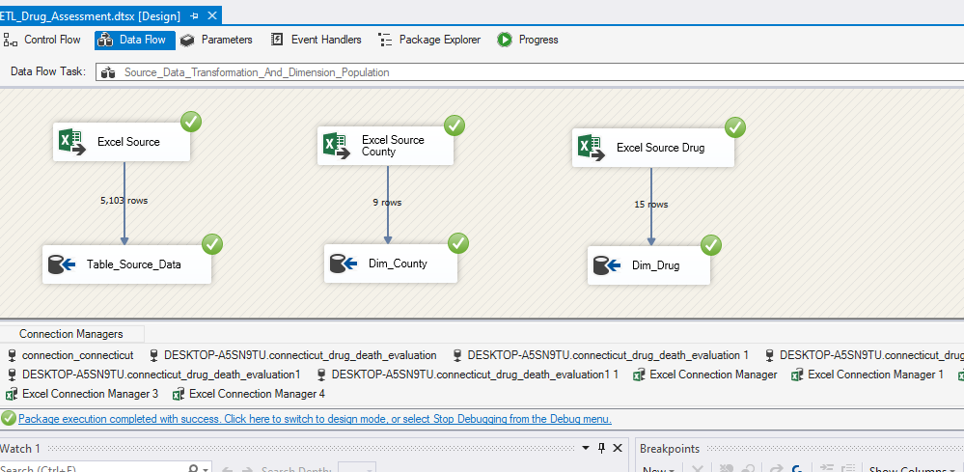
Insertion into dimension and stage source Table

Slide 16
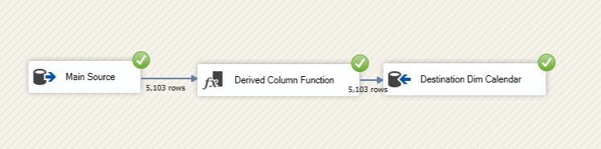
Dimension date derived population

Slide 17
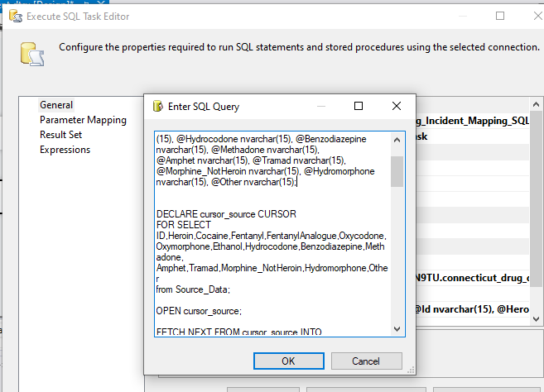
Staging and transformation
Used 2
"Execute SQL Task" component
To insert in
table Drug_Incident_Mapping
Removal of null values based on most
Frequent value

Slide 18
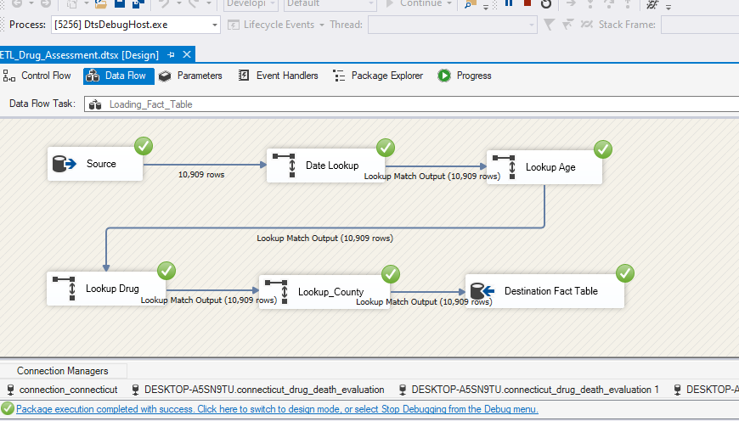
LOADING

Slide 19
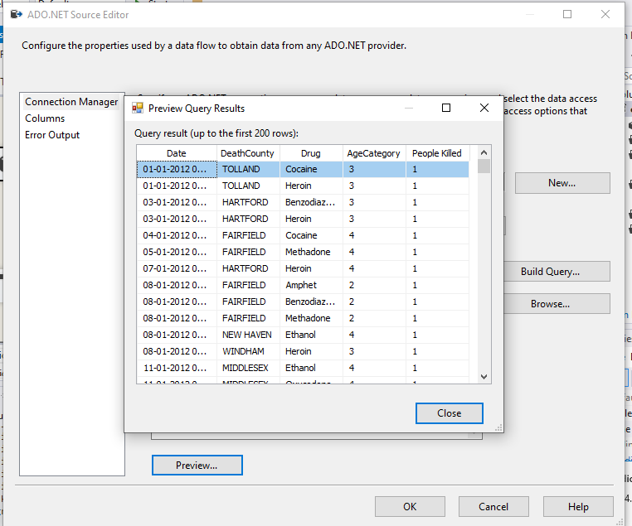
Source Data joined with staging table for lookup

Slide 20
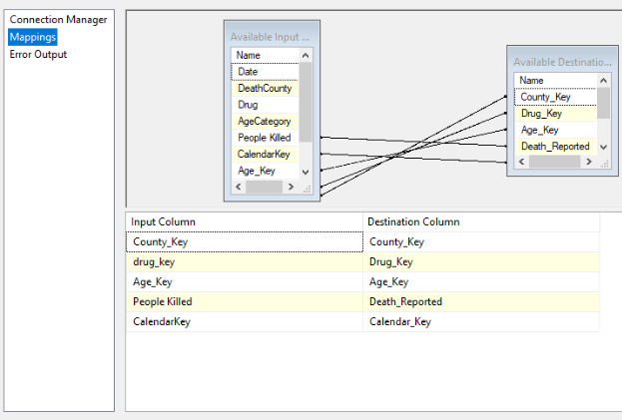
Final mapping

Slide 21
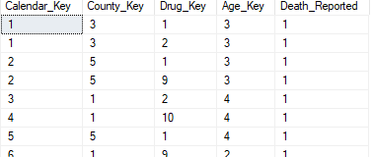
Fact table

Slide 22
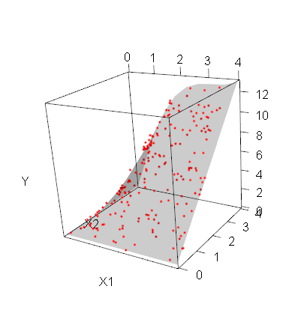
Visualization Using R Programming

Slide 23
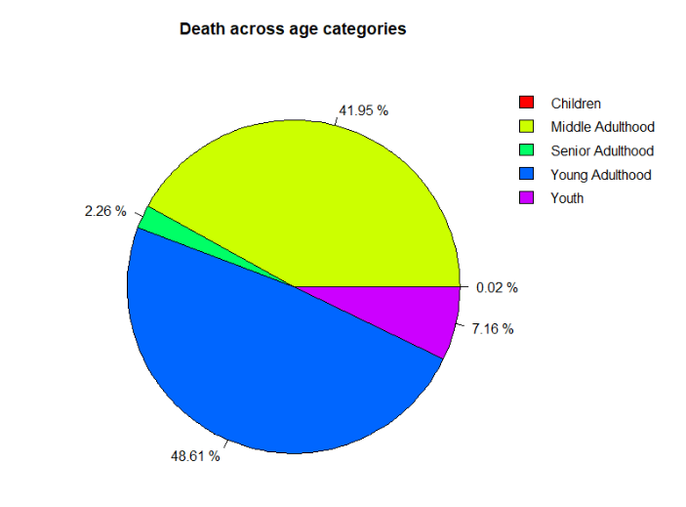
R Visualization & Insights
This pie chart shows the number of deaths according to the age category.
Most of the deaths because of drugs are from young adult category and this is followed by middle adult.

Slide 24
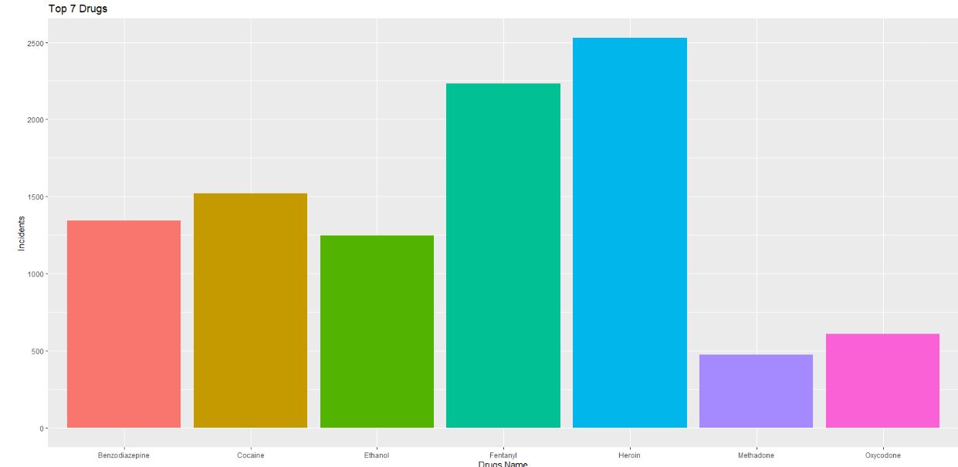
R Visualization & Insights
This graph shows the top 7 drugs in terms of usage in the state
Heroin is at the top and followed by Fentanyl. This shows that these drugs are popular among the users.

Slide 25
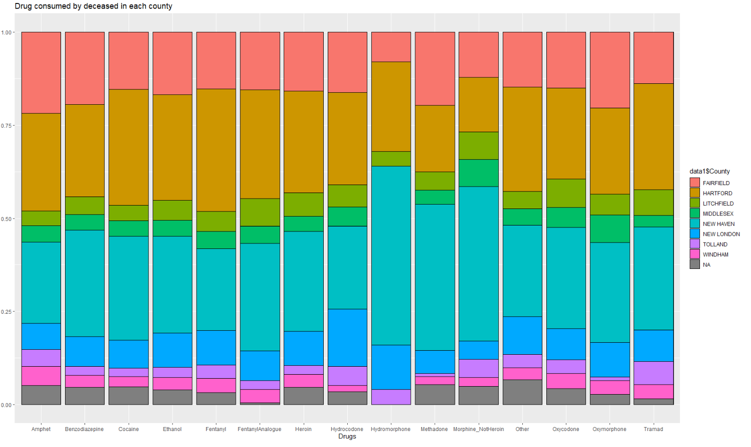
R Visualization & Insights
This graph shows usage of drug in every county
In Hartford and in New Haven all drugs are being used by the people in large numbers

Slide 26
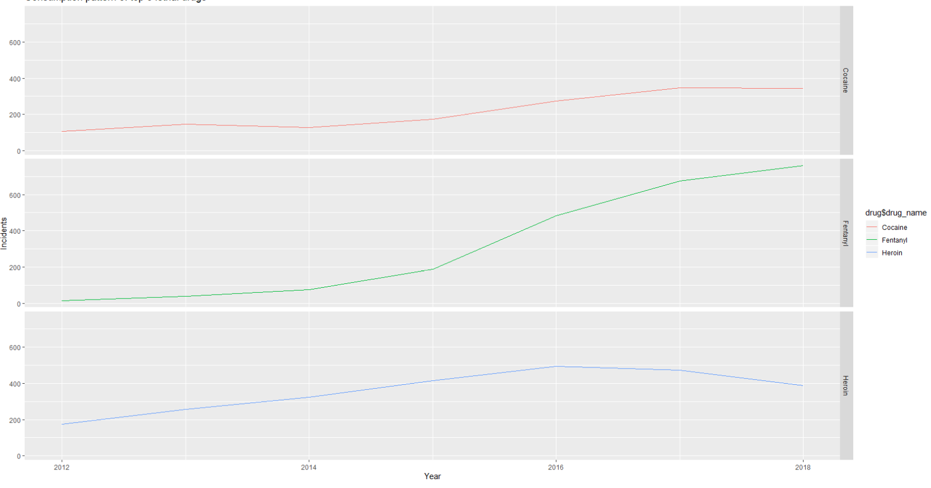
R Visualization & Insights
These line graphs are showing the trend of usage of three lethal drugs in the state.
Use of cocaine is stagnant from late 2016
Fentanyl usage has been increased exponentially from 2015 and it surpassed the other drugs usage significantly
Heroin usage is declining right from the beginning of 2016.

Slide 27

Reports Using ssrs

Slide 28
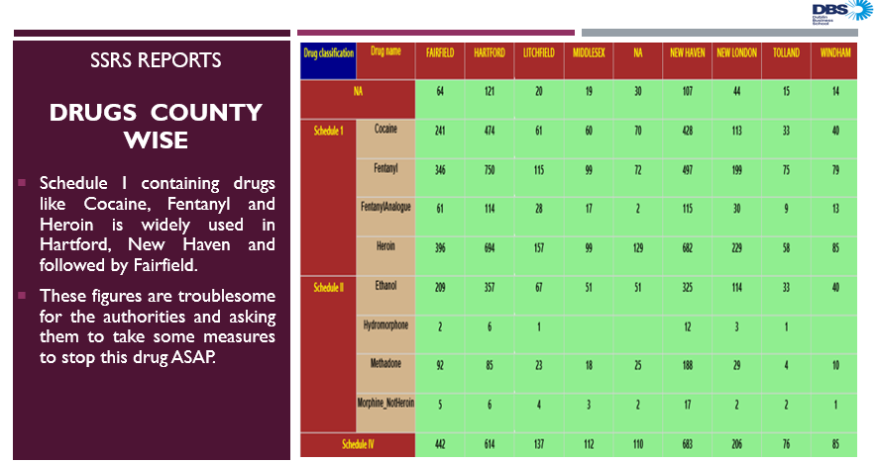

Slide 29
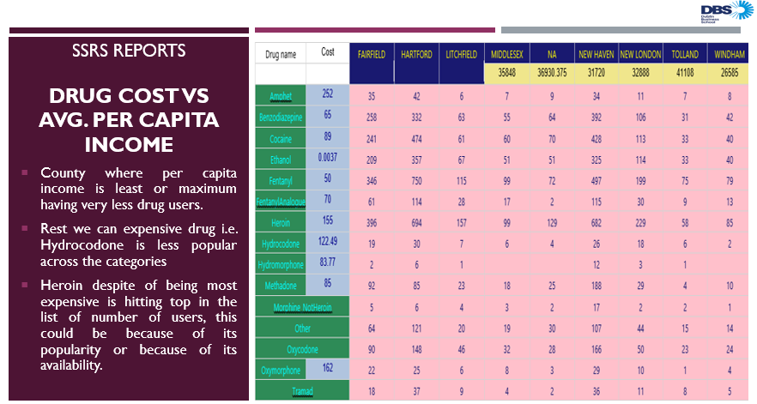

Slide 30
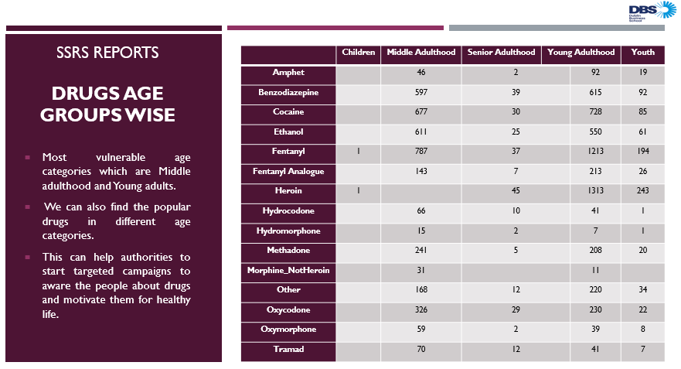

Slide 31
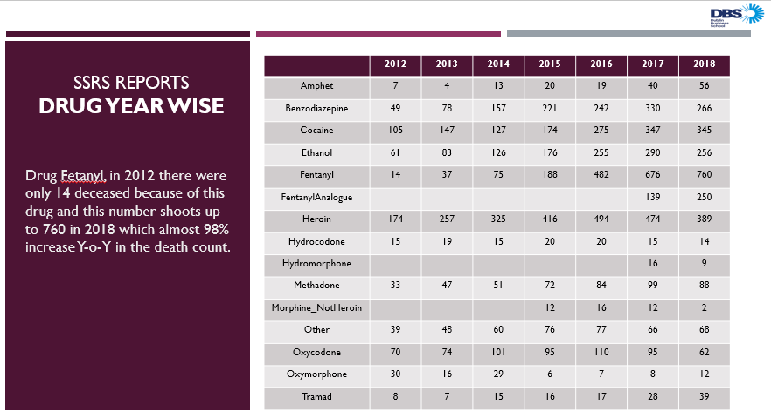

Slide 32

XML & XSD

Slide 33
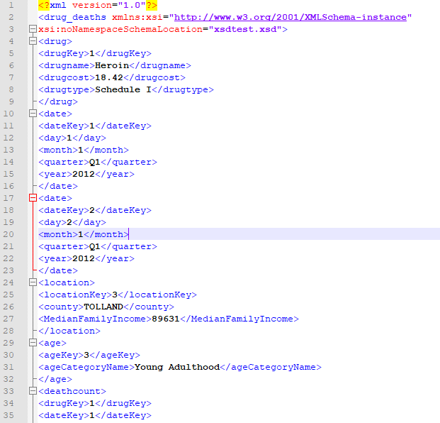
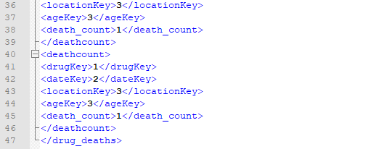
XML

Slide 34
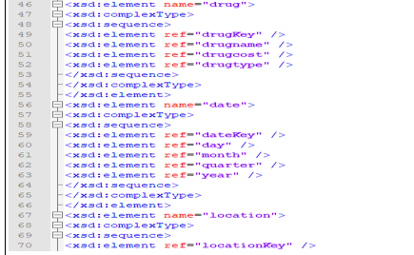
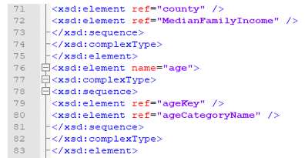
XSD

Slide 35
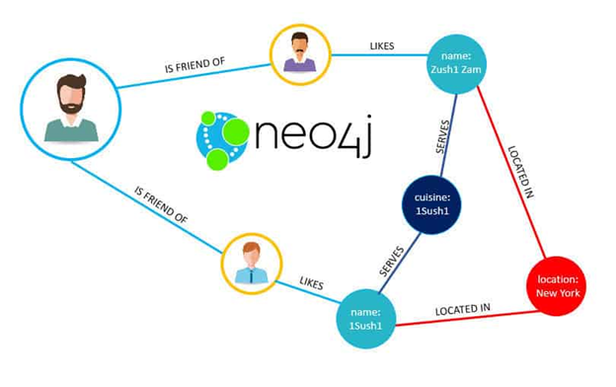
Graph database using neo4j

Slide 36
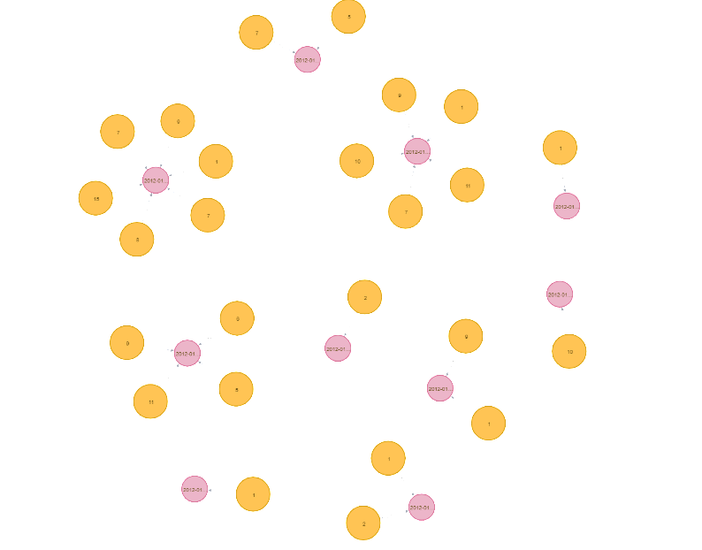
This graph shows the relationship between Calendar Node and Fact Node [Fact-diedon->Calendar]

Slide 37
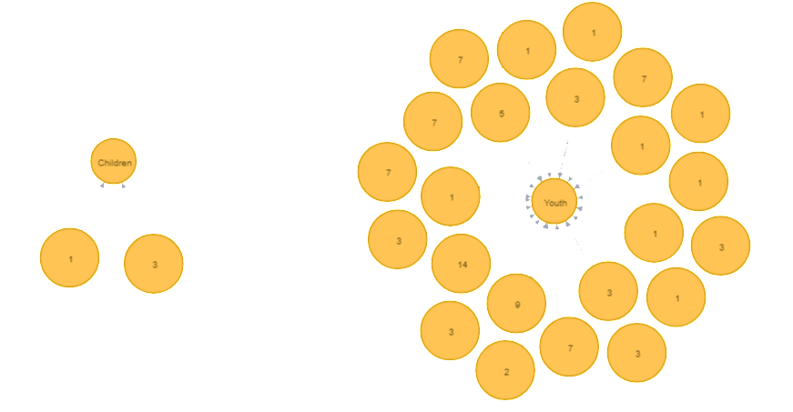
In this graph we have shown the relation between Age Node and Fact Node [Fact-diedat->Age]

Slide 38
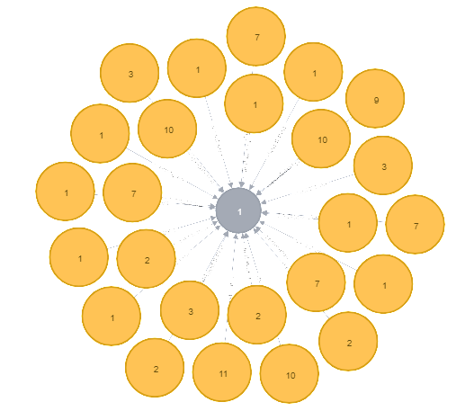
Above we have shown the relation between Area Node and Fact Node [Fact-diedatarea->Area]

Slide 39
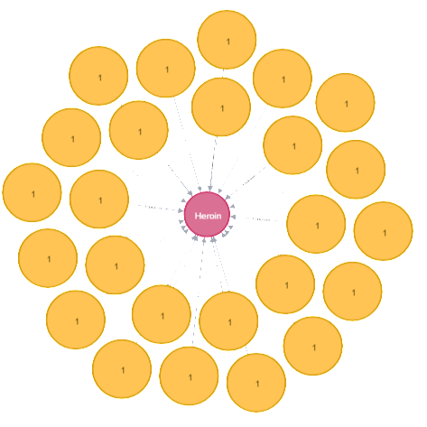
Above we have shown the relation between Drug Node and Fact Node [Fact-took->Drug]

Slide 40
conclusion
Heroin is the drug which is widely used in the state of Connecticut and most prone are people of middle adulthood and youth.
New Haven, Fairfield and Hartford are the counties where maximum incidents happened, so federal departments should take measures to tackle this issue ASAP by alerting local and state police.
Fentanyl is the new drug which is getting popular nowadays, and usage of this has increased exponentially from last few years. So, this drug is new to market and authorities should take strict measures to stop this from getting viral to other states too.
Most of the victims are from age category Young and Medium Adulthood and this is the major point to concern about.

Slide 41
RULE of 3/10
Design of data warehouse is an art, be an ARTIST !
SSIS simplifies ETL, A LOT!
Data is changing, so should our approach to it!

Slide 42

Questions?

Slide 43

Thank you

